Slide 1
Roots and Optimization

Slide 2
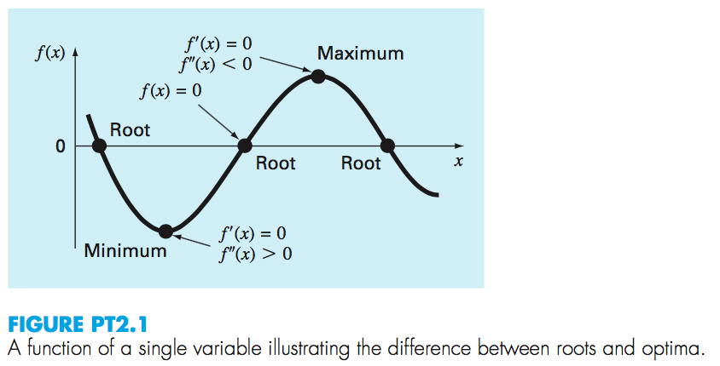

Slide 3
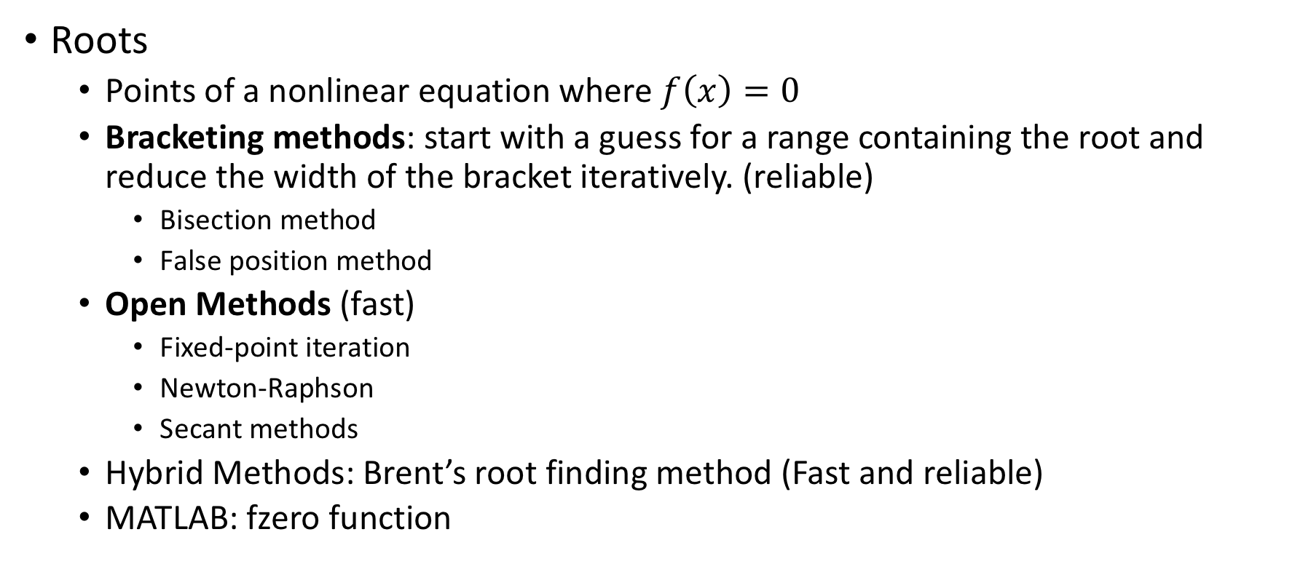
Overview
Roots
Points of a nonlinear equation where $f\left(x\right)=0$
Bracketing methods: start with a guess for a range containing the root and reduce the width of the bracket iteratively. (reliable)
Bisection method
False position method
Open Methods (fast)
Fixed-point iteration
Newton-Raphson
Secant methods
Hybrid Methods: Brent’s root finding method (Fast and reliable)
MATLAB: fzero function

Slide 4
Overview
Optimization
Determining the maximum and minimum values of f(x)
Bracketing methods:
Golden-section search
Parabolic interpolation
Hybrid approach: combine golden-section and quadratic interpolation
MATLAB: fminbnd
Multidimensional optimization
MATLAB: fminsearch

Slide 5
Roots: Bracketing Methods

Slide 6
Chapter Objectives
Understanding what roots problems are and where they occur in engineering and science.
Knowing how to determine a root graphically.
Understanding the incremental search method and its shortcomings.
Knowing how to solve a roots problem with the bisection method.
Knowing how to estimate the error of bisection and why it differs from error estimates for other types of root location algorithms.
Understanding false position and how it differs from bisection.

Slide 7
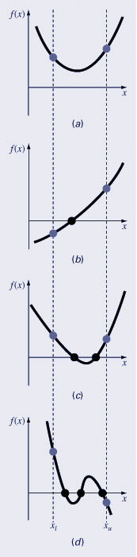
Graphical Methods
A simple method for obtaining the estimate of the root of the equation f(x)=0 is to make a plot of the function and observe where it crosses the x-axis.
Graphing the function can also indicate where roots may be and where some root-finding methods may fail:
Same sign, no roots
Different sign, one root
Same sign, two roots (even number of roots)
Different sign, three roots (odd number of roots)

Slide 8
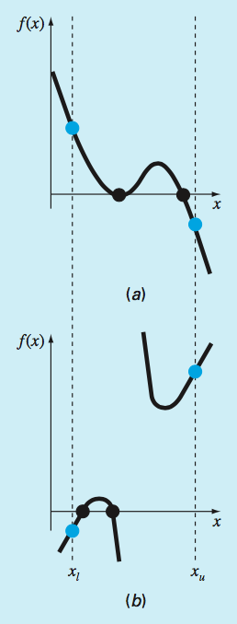
Exceptions

Slide 9
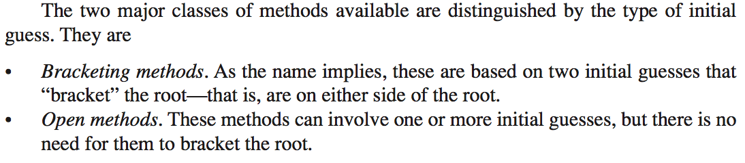

Slide 10
Roots
Bracketing Methods:
Always work
Converge slowly
Open Methods
Do not always work (can diverge)
Converge quicker

Slide 11
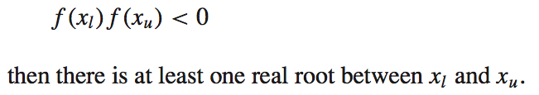
Incremental search
Approach to obtain initial guesses
The incremental search method tests the value of the function at evenly spaced intervals and finds brackets by identifying function sign changes between neighboring points.
If

Slide 12
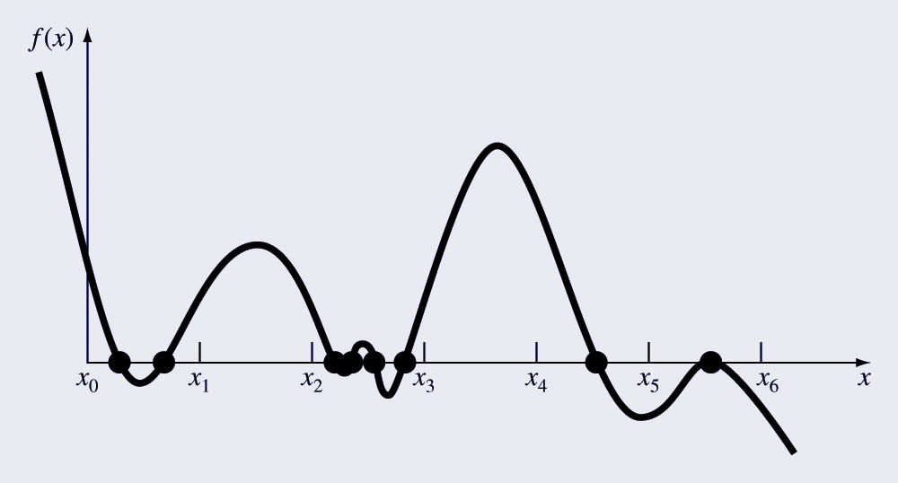
Incremental Search Hazards
If the spacing between the points of an incremental search are too far apart, brackets may be missed due to capturing an even number of roots within two points.
Incremental searches cannot find brackets containing even-multiplicity roots regardless of spacing.

Slide 13
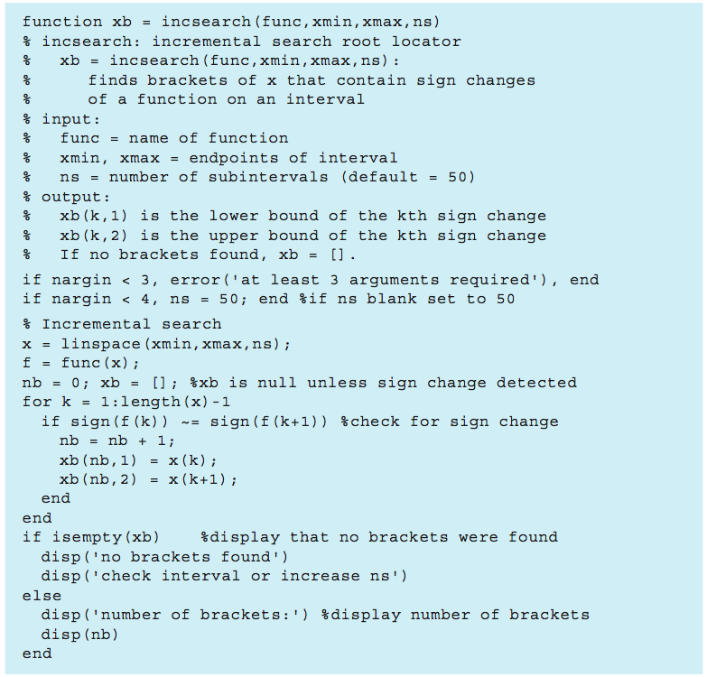

Slide 14

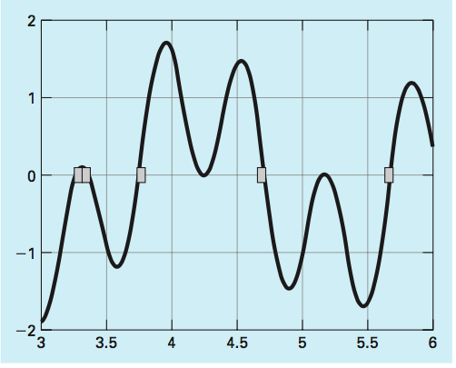
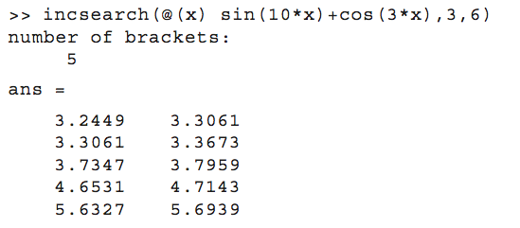
Example

Slide 15
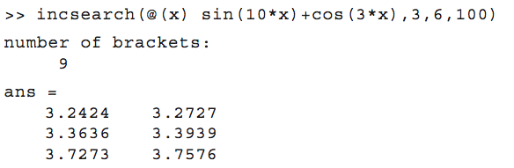
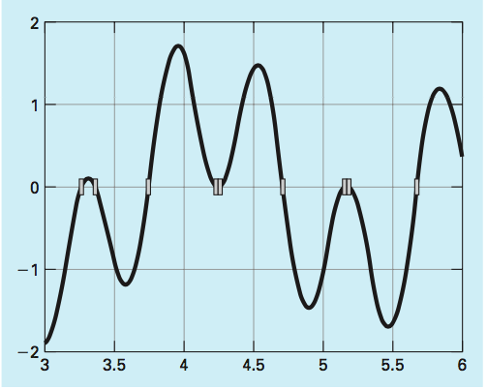
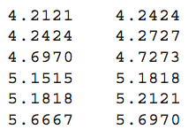
Example
Run with more subintervals

Slide 16
Bisection Method

Slide 17
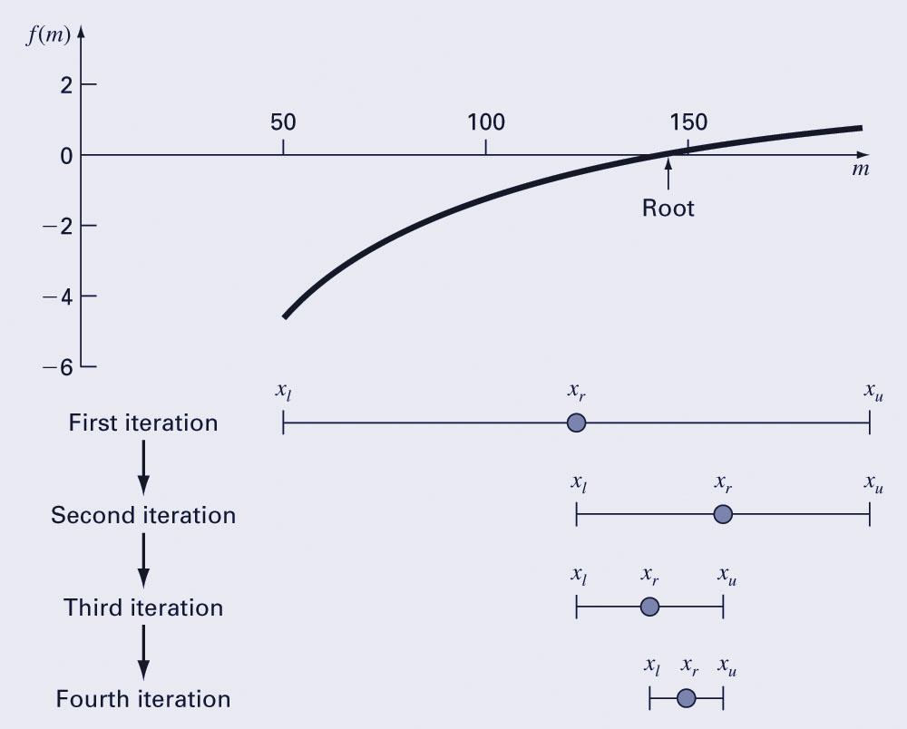





Bisection Method
The bisection method is a variation of the incremental search method in which the interval is always divided in half.
If a function changes sign over an interval, the function value at the midpoint is evaluated.
The location of the root is then determined as lying within the subinterval where the sign change occurs.
The absolute error is reduced by a factor of 2 for each iteration.

Slide 18



Bisection Method

Slide 19

Bisection Method
Iterate until the result is accurate enough.
We need an error estimate that does not require the knowledge of the true root.
Stop when the approximate relative percent error is below some value eps.
Approximate relative percent error:

Slide 20
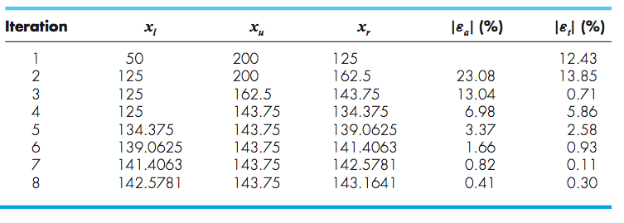
Bisection Method

Slide 21
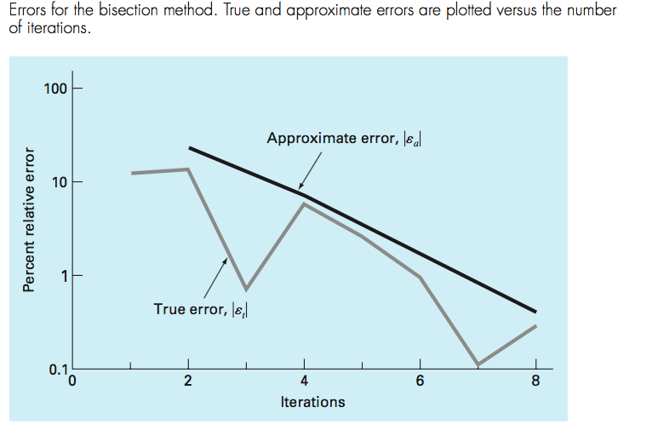

Bisection Method

Slide 22




Bisection Method
The number of iterations required to attain an absolute error can be computed a priori (before starting the iterations).
Before starting the absolute error is less than:
After the first iteration the error is less than:
Since each iteration halves the error, a general formula relating the error and the number of iterations is:

Slide 23
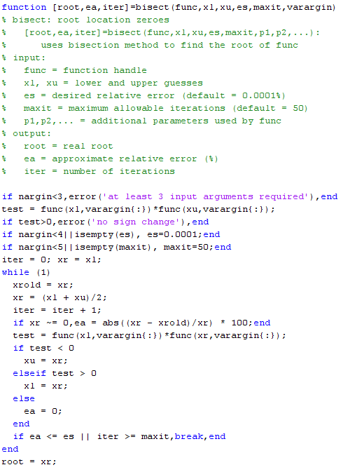


Slide 24

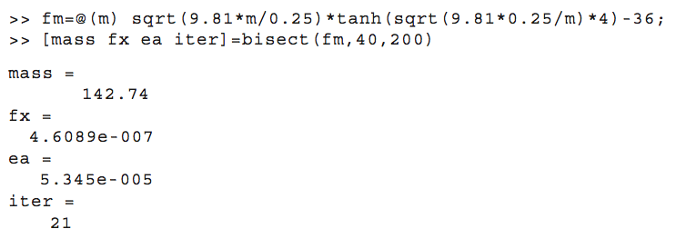
Bisection Method
Find the root of

Slide 25
False Position Method

Slide 26
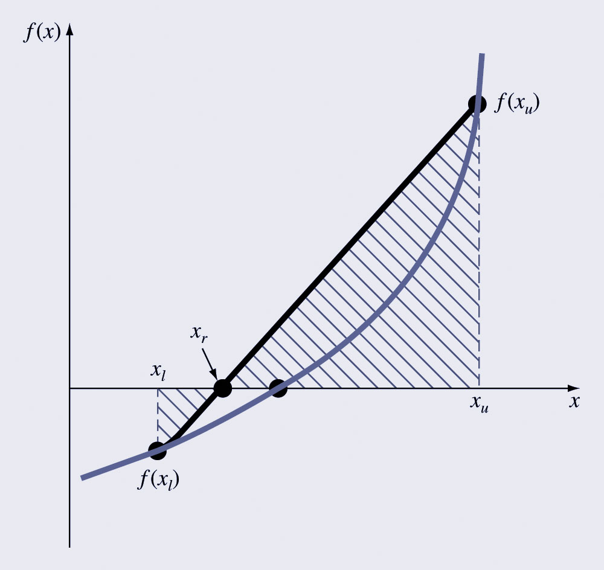
False Position Method
The false position method is another bracketing method.
It determines the next guess not by splitting the bracket in half but by connecting the endpoints with a straight line and determining the location of the intercept of the straight line (x_{r}).
The value of x_{r} then replaces whichever of the two initial guesses yields a function value with the same sign as f(x_{r}).
False position formula

Slide 27
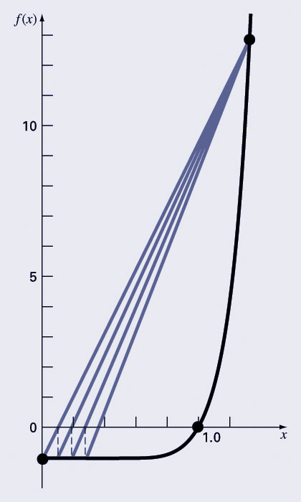
Bisection vs. False Position
Bisection does not take into account the shape of the function; this can be good or bad depending on the function!
Slow convergence:

Slide 28
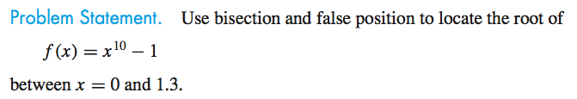
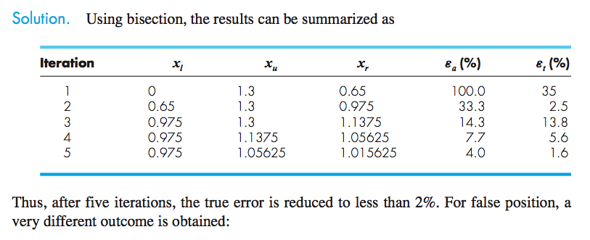
Example

Slide 29
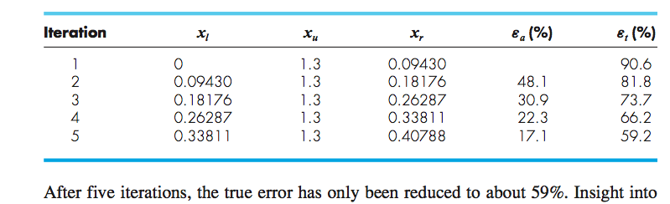
Example
This function violates the assumption that if f(x_l) is much closer to zero than f(x_u), then the root should be
much closer to x_l than x_r.

Slide 30
Summary
Although false position is generally superior to bisection, there are cases where this is not true.
False position is one-sided: one of the bracketing points will stay fixed. This can lead to poor convergence.
The results should always be checked by substituting the root estimate into the original equation and confirming that the result is close to zero.

Slide 31
Overview
Roots
Points of a nonlinear equation where $f\left(x\right)=0$
Bracketing methods: start with a guess for a range containing the root and reduce the width of the bracket iteratively. (reliable)
Bisection method
False position method
Open Methods (fast)
Fixed-point iteration
Newton-Raphson
Secant methods
Hybrid Methods: Brent’s root finding method (Fast and reliable)
MATLAB: fzero function

